Slide 1
Kevin’s Knick Knacks
Digital Binder
Ryan L. Buchanan

Slide 2
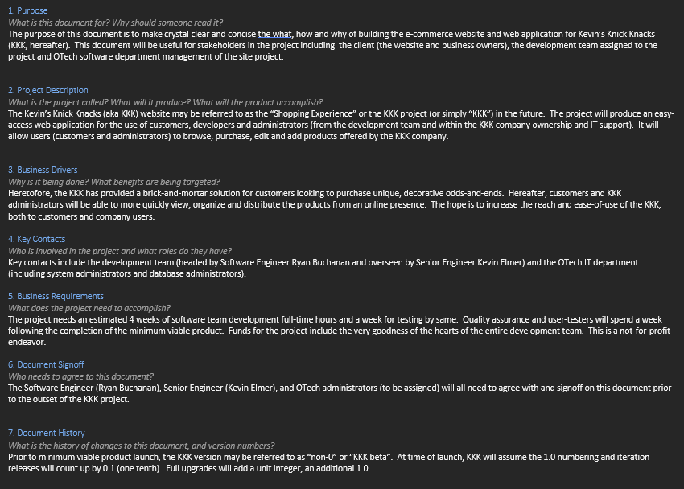
Requirement Analysis Document

Slide 3
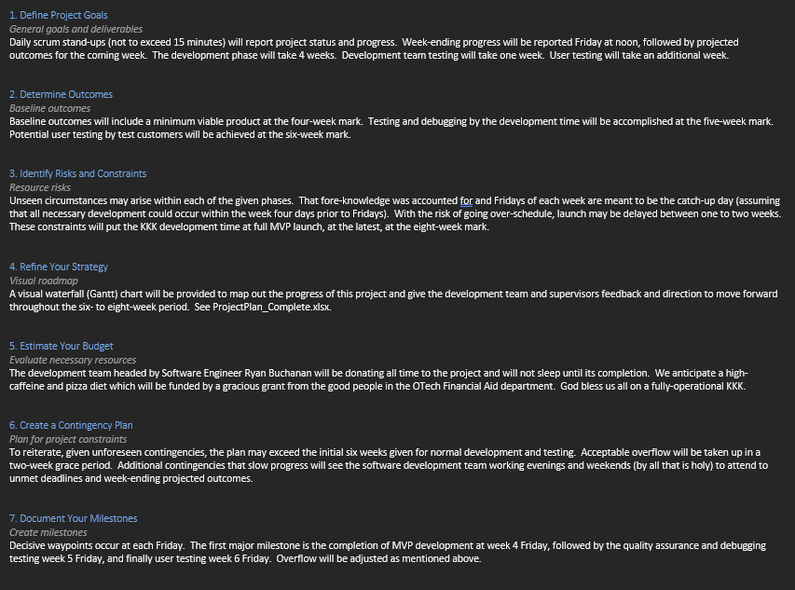
Project Design

Slide 4
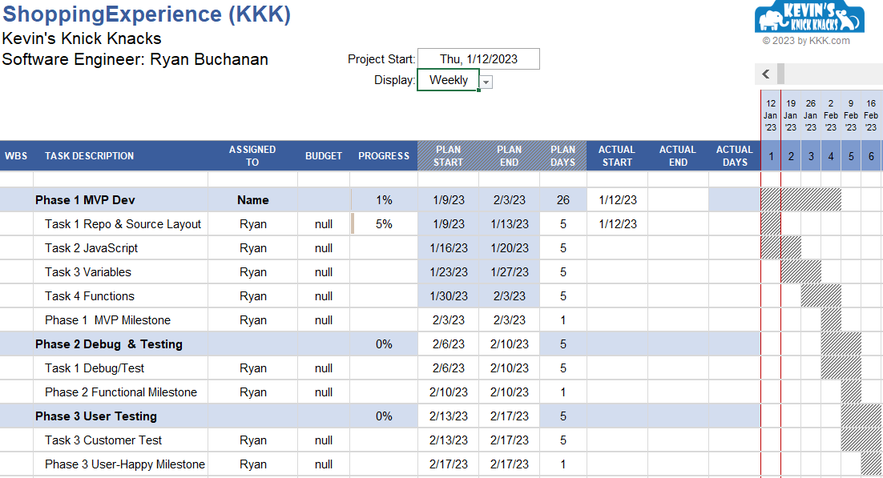
Project Plan

Slide 5
User Stories
As Karen, I want to go online and find a garden gnome of exquisite craftsmanship, so I don’t have to shop the plethora of yard and estate sales every spring and come up with just sore legs.
As Nigel, I want find a good find a long-tail, unique knick knack website, so I can see an organizational database of curios in one place and don’t have to go to Amazon for everything.
As Henrietta, I want to buy special and safe toys for my grandniece in the Cyberspace, so I can become more tech savvy in the eyes of my young relations.

